Slide 1

You Are Open To Experience
Creative
Imaginative
Adventurous
Intellectual
Unconventional
Artistically Inclined
Career Tip: Look for a Career that gives you:
A free work environment with less restrictions
Opportunity to learn and do novel things
Implement new methods and processes!
You Are

Slide 2

You Are Moderately Open To Experience
Choosy About Trying New Things
Possess Average Variety of Interests
Prefer Somewhat Familiar Experiences
Moderately Imaginative
You Are
Career Tip: Look for a Career that gives you:
A moderately structured work environment
Opportunity to learn and train yourself in new processes
Chance to work upon your ideas but have some Some system of knowing the Feedback on your performance!

Slide 3

You Are Low In Openness To Experience
Grounded in Reality
Un-Imaginative
Conventional
Un-Curious
Possess Narrow Interests
Un-Artistic
You Are
Career Tip: Look for a Career that gives you:
A Highly structured work environment with a fix routine of 9 to 5 office job
A known and familiar work of your mastery
Chance to prove your abilities in a set pattern of work with regular feedback on your performance

Slide 4

You Are High In Agreeableness
Trusting
Lenient
Soft-Hearted
Good-Natured
You Are
Career Tip: Watch out for these at your Career front:
Inculcate assertiveness to put forward your ideas
Develop confidence in pursuing independent goals
Avoid being too trusting and blindly following or affirming to others viewpoint

Slide 5

You Are Moderate in Agreeableness
Balanced in Approach Towards Self & Others Interests
Helpful to Others Sometimes
Inclined to Mostly Watch Out for Your Interests First
You Are
Career Tip: Watch out for these at your Career front:
Develop more perspective for understanding others
Inculcate habit to look out for others interest too
Try and be a team player and work upon developing cooperation and common goals while working in a group

Slide 6

You Are Low In Agreeableness
Suspicious
Critical
Ruthless in Pursuit of Goals
Given to Irritability
You Are
Career Tip: Watch out for these at your Career front:
Develop perspective for understanding others
Inculcate habit to care, show concern and look out for others interest
Be Tolerant and patient to differences of opinion
Try and be a team player and work upon developing trust, cooperation and common goals while working in a group

Slide 7
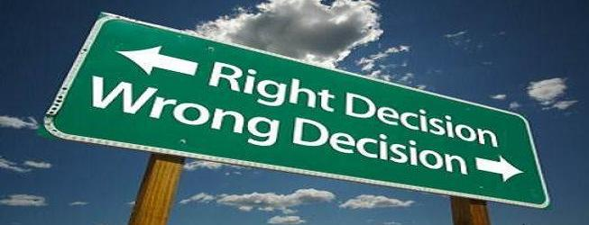
You Are Highly Conscientious
Orderly
Dependable
Hardworking
Cautious
You Are
Career Tip: Watch out for a Career where You:
Get to work in an orderly manner
Get your Hard work paid off with rewards of appreciation
Are in a key position and have to take care of lots of deadlines and work
Hold a key position of responsibility where you have to maintain highly confidential information also

Slide 8

You Are Moderately Conscientiousness
Average in Impulsiveness
Given to Long-Term Planning of Goals
Given to Sometimes Getting Side Tracked With Diversions
You Are
Career Tip: You will do better in a career where you:
Don’t feel bound by extremely imposed rules and regulations
Get a moderately lively approach to work
Can get away sometimes from leaving things to chance
Do not have to be in a very responsible profile requiring high level of confidentiality and dedication

Slide 9
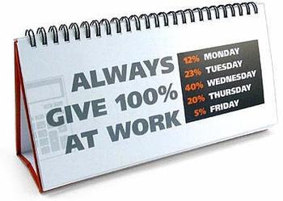
You Are Low In Conscientiousness
Impulsive
Disorganized
Spontaneous
Carefree
You Are
Career Tip: You will do better in a career where you:
Do not feel bound by imposed rules and regulations
Can work in your own style and are not in a key position of responsibility
Can work on your ideas without being concerned much about deadlines and in least organized way

Slide 10

You Are Highly Extraverted
Friendly
Gregarious
Active
Enthusiastic
Ambitious
Talkative
Outgoing
You Are
Career Tip: You will do better in a career where you:
Get to work with people and motivate / convince them for some idea
Get to talk and interact with others to get a work done
Get to climb up the career ladder to reach a high status and well paid job
Can employ your social confidence and people’s skills to bring energy and motivation in the team and work on a common goal by leading from the front.

Slide 11

You Are Moderately Extraverted
Average in Motivation to Seek Out Social Reward
Content when You’re Not Winning Recognition
Somewhat Moderate in Desire For Admiration, Influence and Prestige
You Are
Career Tip: You will do better in a career where you:
Have to interact with people but do not have to go out of your way to interact with them
Have some opportunity to maintain privacy also when you occasionally feel the need
Occasionally get some social recognition for your work

Slide 12
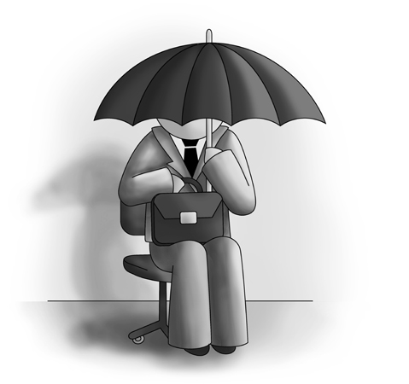
You Are Low In Extraversion
Reserved
Independent
Quiet
Deliberate
Passive
Loner
You Are
Career Tip: You will do better in a career where you:
Have to work independently and in privacy
Have to interact least with the people and focus more upon your own ideas and work
Do not have to engage in public handling or public speaking

Slide 13

You Are Low In Neuroticism
Calm
Even-Tempered
Comfortable
Emotionally Stable
Carefree
Optimistic
Relaxed
Self-Confident
You Are
Career Tip: You will prove your mettle in career by:
Working under stress and time limits
Proving your abilities under high pressure situations
Leading and making crucial decisions and maintaining the morale of the team in adverse circumstances
Working in difficult circumstances and minimal resources

Slide 14

You Are Moderate In Neuroticism
Average in Experiencing Negative Emotions
Not Overly Reactive
Somewhat Moderate in Resistance to Stress
You Are
Career Tip: You will do well in a career where you:
Do not have to work under too much pressure
Have comfortable working conditions and only occasional stress of deadlines and time limits
You do not have to lead and maintain morale of the team under high pressure situations & adverse circumstances

Slide 15

You Are High In Neuroticism
Worried
Temperamental
Self-Conscious
Prone to Stress
Highly Emotional
Anxious
You Are
Career Tip: You will do well in a career where you:
Have to work under an able supervision which shows understanding and compassion
Have comfortable working conditions without any time limits and deadlines
Have to simply follow work rules and instructions without much worries about the financial targets
Least disturbed with emotional situations where you have to control your temper

